Slide 1
“FOOD-DELIVERY”
Task - 1

Slide 2

FOOD DELIVERY
Your Project Introduction
LMS Username | Name | Batch
2113a53249 | NAVEEN D | A53
2113a53242 | KISHORE KUMAR R | A53
2113a53216 | ARAVIND GOSH S | A53
2113a53222 | DEEKAN S | A53

Slide 3
Task - 1
Creation of SRS & Github
Create SRS : “FOOD DELIVERY”
Creation & Set-up of Github account
Creation & Hands-on to various commands of Git Bash
Evaluation Metric:
100% Completion of the above tasks
Learning Outcome
Get to know about different lifecycle models.
Understanding importance and how to create an SRS
Knowing various commands of Github
Understanding agile and scrum management techniques for efficient product development

Slide 4
SRS for “FOOD DELIVERY"
Functional Requirements
Push notifications.
Discount/Rewards/Cashbacks.
Real time GPS tracking.
Easy payment options.
Reviews & Ratings.
Easy order placements.
Order scheduling and pickup.
QR Codes.
Geofencing.
Search filters.
Order history.
In-app messages.
Favorites.
Contactless delivery.
Voice recognition.

Slide 5
SRS for “FOOD DELIVERY"
Non Functional Requirements
Loading speed.
Time taken to deliver server response.
User response time.
Data consumption limits.
Refresh food lists every 5 minutes.
Order conformation must be done quick.

Slide 6
SRS for “FOOD DELIVERY"
Software Requirements
The software shall be capable of supporting an arbitrary number of surface computers. tablets and displays, that is, it shall provide no limit on how many devices are in the system. It shall be capable of supporting an arbitrary number of active meals/orders, that is, no meals/orders shall be lost under any circumstances.

Slide 7
SRS for “FOOD DELIVERY"
Hardware Requirements
These devices are the surface computers, the wireless tablets and the touch displays. All three devices must be physically robust and immune to liquid damage and stains. The devices (with the possible exception of displays) must also have good industrial design aesthetics, as they are to be used in place of normal restaurant tables and notepads and will be in direct contact with customers.

Slide 8
Step-Wise Description
Initial Requirements Collection
Start of DB structure
Start of Front End Development
End of DB structure
Completion of Front End
Start of Back End
Complete entire app
Test of App
Deployment
Summary of your task
Each task is scheduled among the members of the team according to their interest

Slide 9
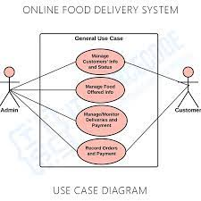
USE CASE DIAGRAM

Slide 10
CLASS DIAGRAM

Slide 11
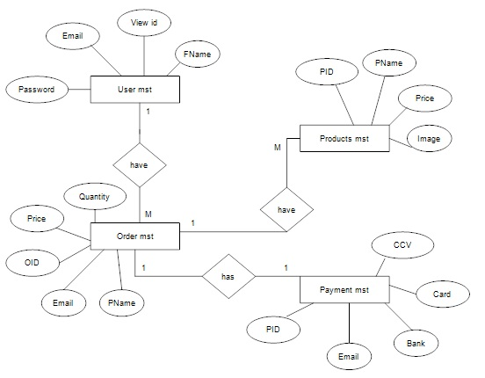
ENTITY RELATIONSHIP DIAGRAM

Slide 12
GITHUB LINK
https://github.com/Naveen1102002/Group_A53_8

